Slide 1







CIMdata Briefing December 2010
Solutions for Performance Driven Companies
Aras Overview
enterprise MPM solution

Slide 2
Aras Innovator Manufacturing Process Planning
Community Solution used by:
US Army, Lockheed Martin, Ingersoll-Rand, L-3 Communications, Rolls-Royce, and GE Aviation
Original IP acquired from CIMtelligence (IntelliCAPP) in 2000

Slide 3

Core Services
Forms
Workflow
Configurations
Vaulting
Versioning
Viewing
Dashboards
Reports
BI
“Digital Manufacturing”

Slide 4
Community Solutions
Manufacturing
Process
Planning
Routing
Setup/Run Time
Method Sheets
Setup Instruction
Work Instructions
Tool List
Material Pick List
Resources
Skills
Assets
Tooling
Calibration
Tool Crib
Tool BOM
Maintenance
MBOM
Core Services
Forms
Workflow
Configurations
Vaulting
Versioning
Viewing
Dashboards
Reports
BI
“Digital Manufacturing”

Slide 5
Community Solutions
Manufacturing
Process
Planning
Tooling
MBOM
Initial Install
Solutions
Core Services
Forms
Workflow
Configurations
Vaulting
Versioning
Viewing
Dashboards
Reports
BI
“Digital Manufacturing”
P-FMEA
Control Plan
Community
Solutions
CAPA
Audit
ISO

Slide 6
Manufacturing
Process
Planning
Tooling
MBOM
“Digital Manufacturing”
Forms
Workflow
Configurations
Vaulting
Versioning
Viewing
Dashboards
Reports
BI
P-FMEA
Control Plan
CAPA
Audit
ISO
Custom Solutions
Data Collection
Logbook
SPC
Serial Traceability
Resource Planning
Inventory
Value Stream Maps
TAKT Analysis
SOE
Family Planning
Standard Work
MES
CAM / PLC
LEAN

Slide 7
Solution Concept
Create and manage version controlled configurations of Manufacturing Process documentation
Source of Manufacturing BOM configurations
Basis for creating Work Orders and shop floor data collection
Multi-media work instruction content (3D, Video, 2D, Lists)
Direct linkage to Tooling database
PLM – to – ERP interface used to promote Routings and WorkCenters to ERP
Direct linkage with Control Plans and Process FMEA’s
Application used by Manufacturing Engineers to author Routings
Kiosk on shop floor, terminals at the work centers, or printed work instructions with Travelers
Copy, Paste, Libraries of routing modules, Part Families, etc. simplify the maintenance of Manufacturing Process Plans
Serialized Traceability or Lot-based Traceability

Slide 8
Solution Data Model
Process Plan
BOM
PART
Produced By
Routing of
Manufacturing Structure ( MBOM )
Certified
workers
Operations
Document
Work
Instructions
Sequence of
Requires
Engineering Structure ( EBOM )
Consumes
Machine
Process Steps
PART
Tools

Slide 9

PLM & ERP Integrated Solution
PLM / MPM / DM
Define & Manage Manufacturing Processes
Procedures & Work Instructions
Lean Six Sigma Operator Information
Manage Equipment, Tooling, Gauges, Consumables
Asset Tracking & Value
ERP / MRP
General Ledger AP/AR
Order Taking
Order Fullfillment
Purchasing
BOM Explosion (MRP)
Labor & Employment
Multiple Integration Points
Visibility Between Systems

Slide 10
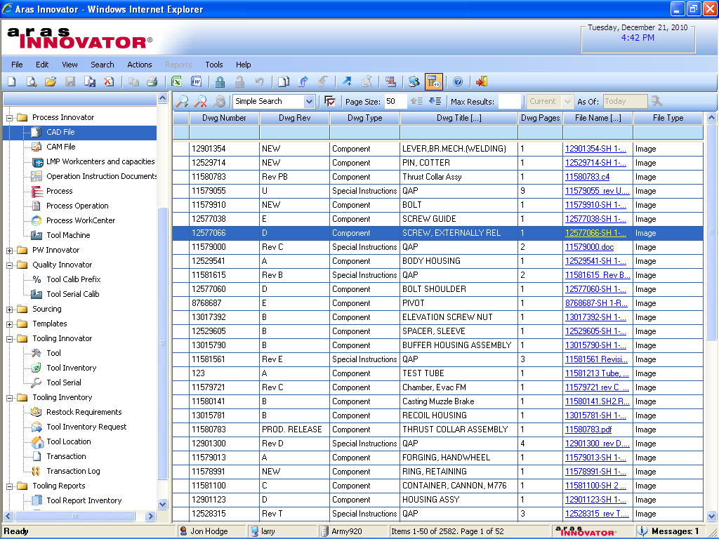
Manufacturing Process CAD Files & Drawings
Manufacturing Process Plans / Routings
Work Instructions & Workcenters
Lean Six Sigma Graphical Method Sheets
CAD & CAM file management
Machines, Tooling, Gauges, Consumables
Preventive Maintenance
PM Schedule & Instructions
Tool Crib w/ Check-in / Check-out
Tooling Designs
Tool Sourcing
Tool Inventory for Fixed Assets & Consumables

Slide 11
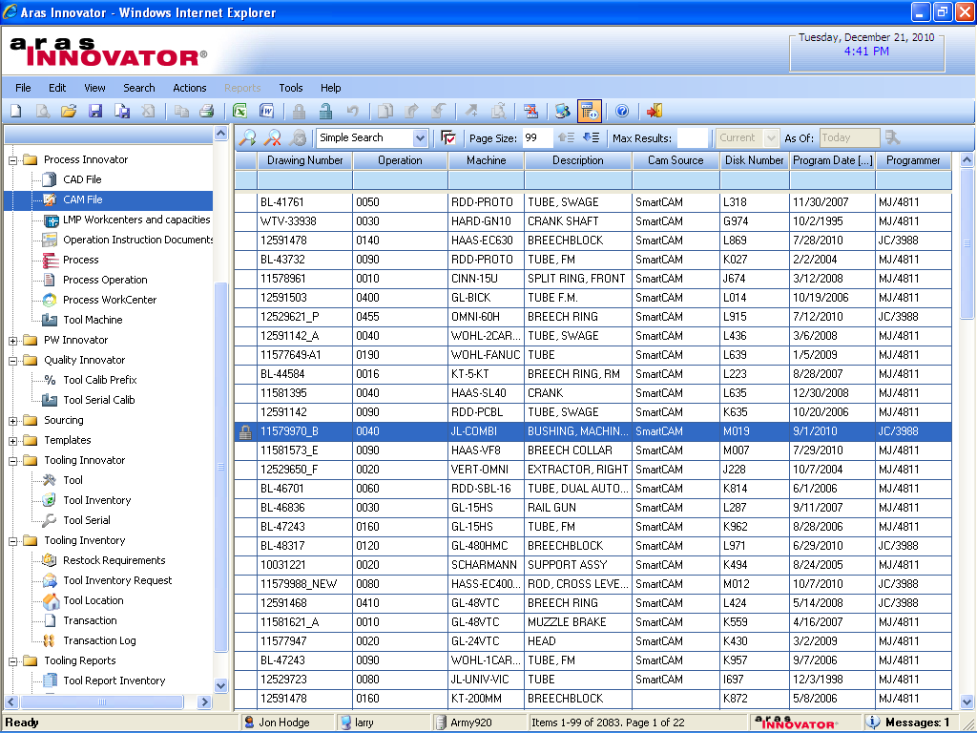
Manufacturing Process CAM Files
Multi-CAD and
Multi-CAM
File Management

Slide 12
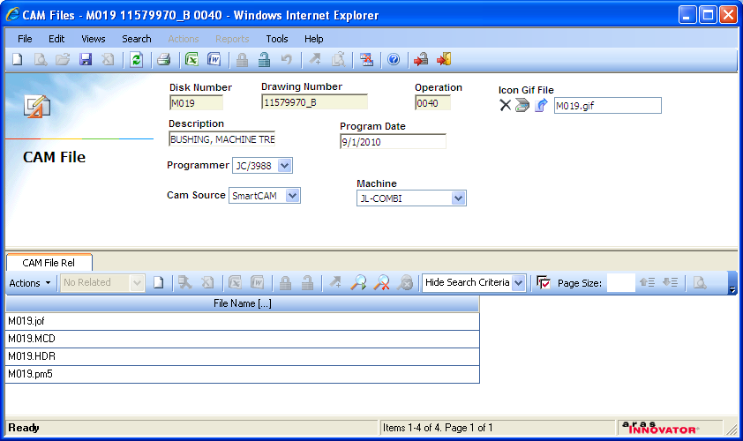
CAM File Details
CAM files associated to specific operations & parts/drawings

Slide 13
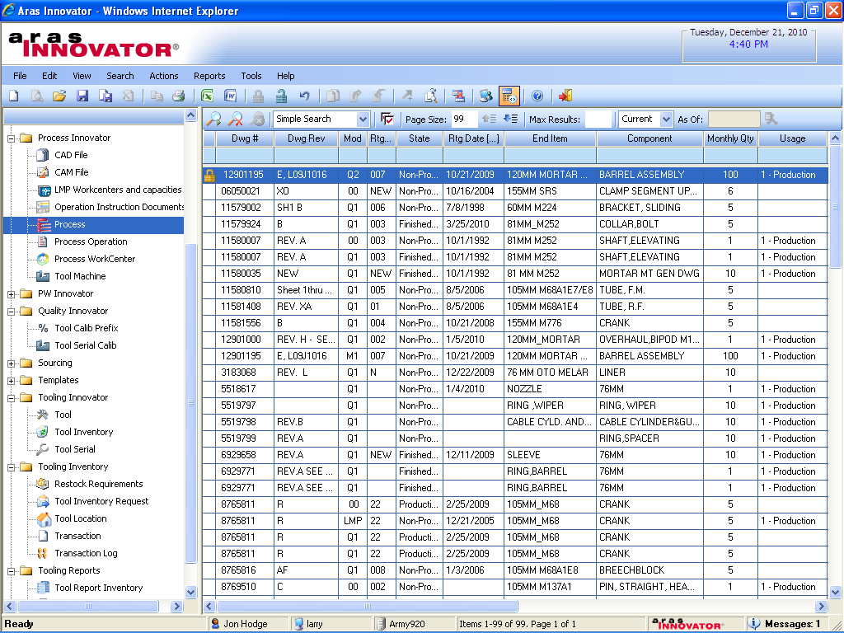
Manufacturing Process Plans
Configurable Manufacturing Process Planner

Slide 14
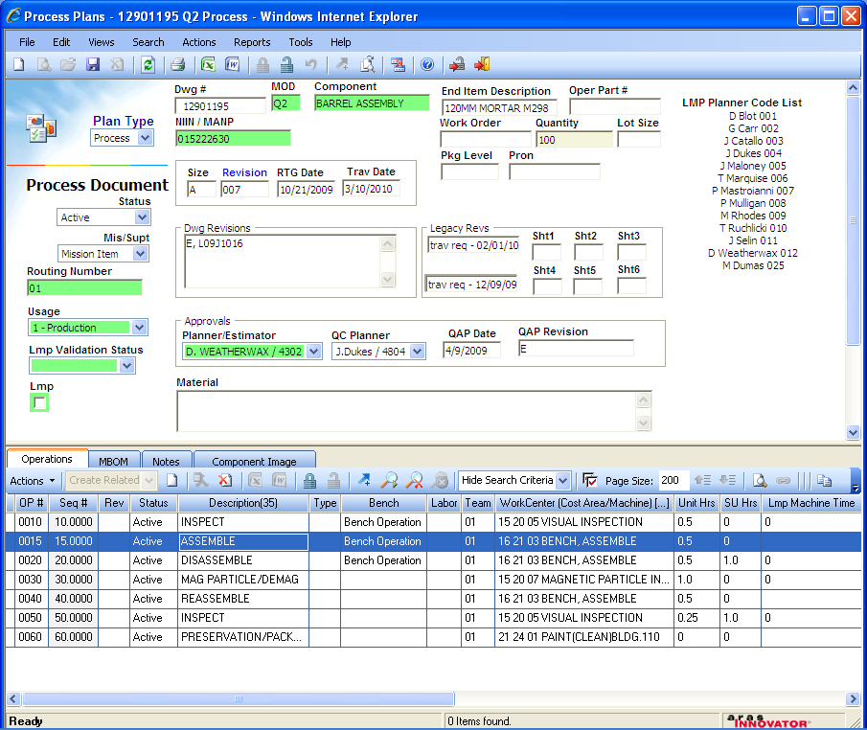
Process Plan Details & Routing
Tailorable Screen Layout, Fields, Labels, Picklists, Required Fields and more
Multi-Language Capability
Process Plan Details by Part/Drawing
Process Steps in Routing

Slide 15
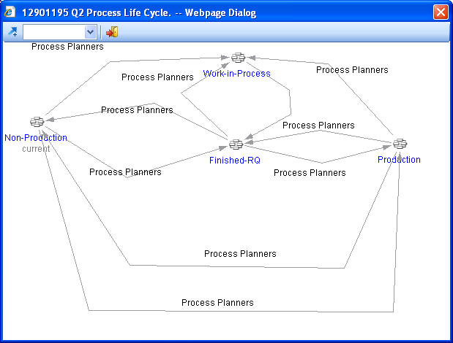
Process Plan Lifecycle
Configurable Lifecycle Map & State Structures

Slide 16
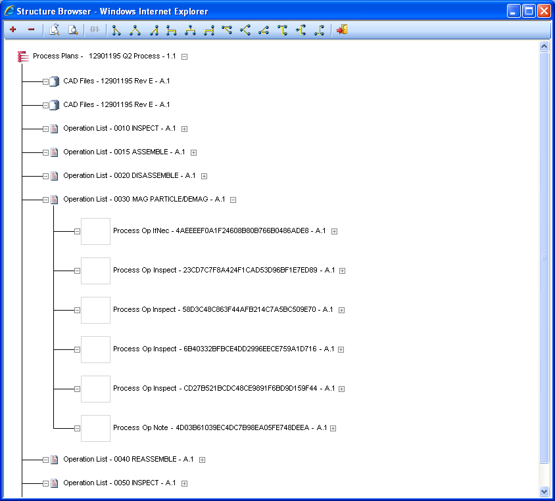
Process Plan Structure
Associated CAD/CAM files
Associated Inspections
Assembly Operations
Work Instructions by Operation

Slide 17
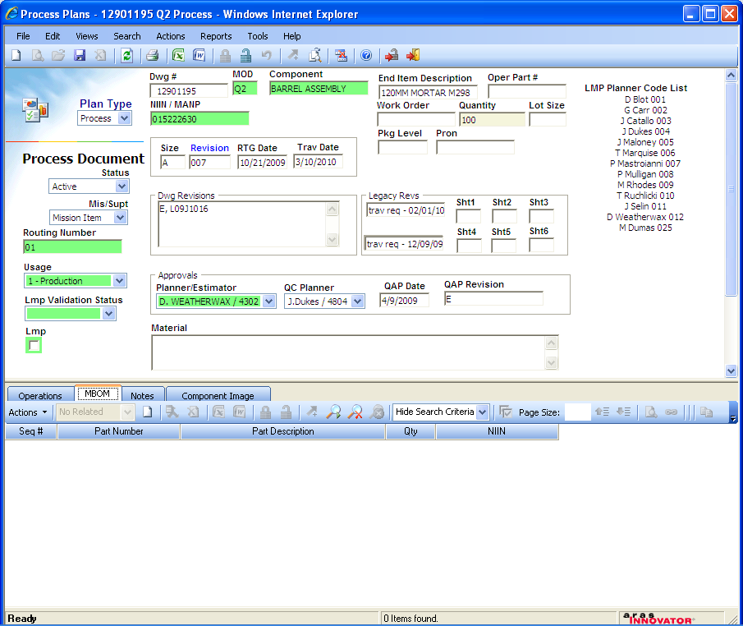
Process Plan Details & MBOM
MBOM Parts & Description
MBOM Assembly Sequence
MBOM Part Quantities

Slide 18
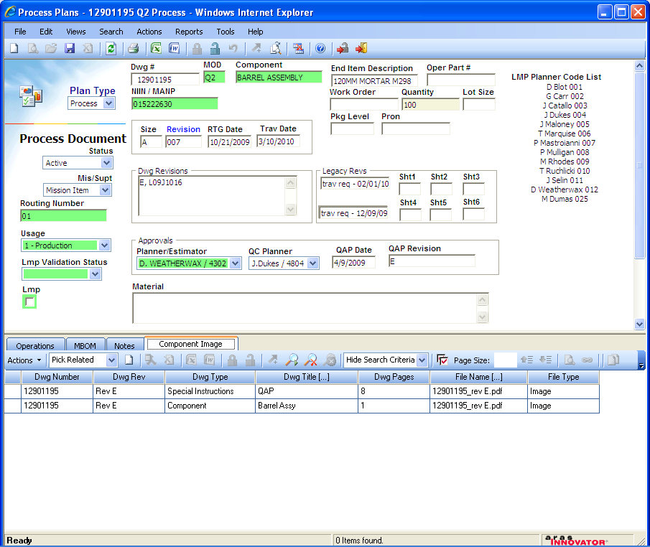
Process Plan with Drawings
Drawing DWG # & Rev
Drawing File

Slide 19
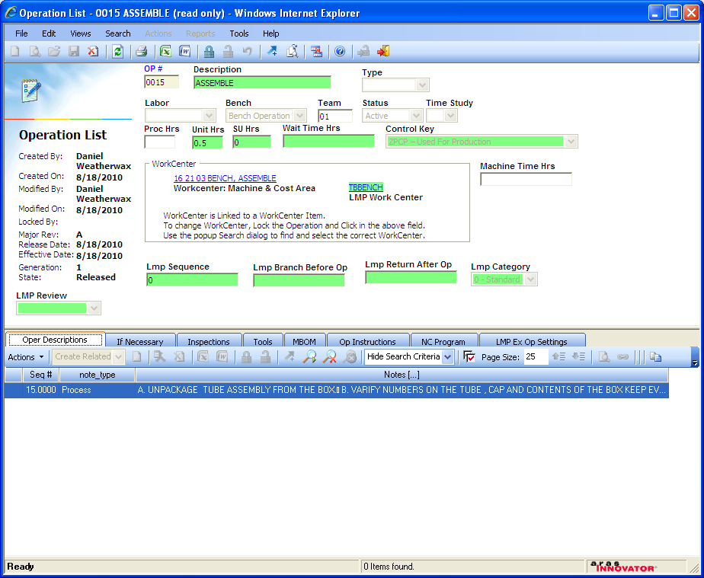
Manufacturing Operation WorkCenter Steps
Operation Steps & Work Instructions, Lean Six Sigma Sequence of Events

Slide 20
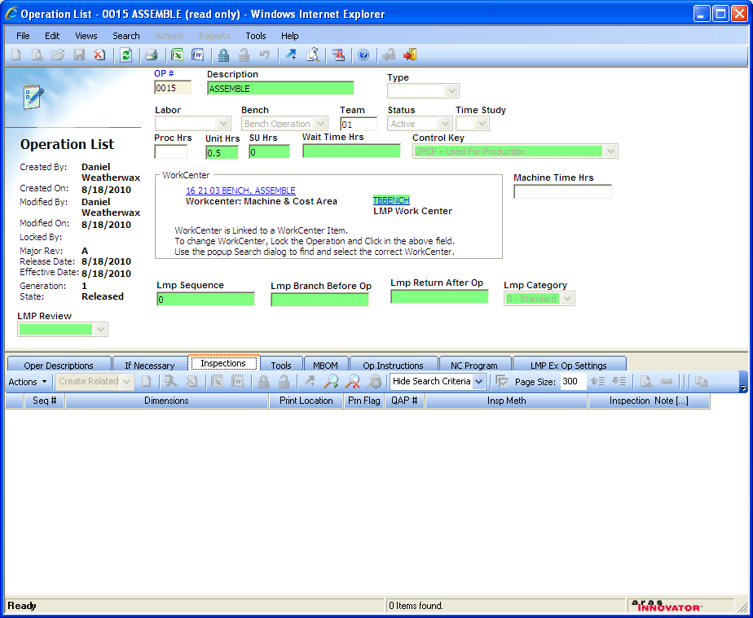
Manufacturing Operation Inspections
Quality Inspections Integrated into Operation Steps

Slide 21
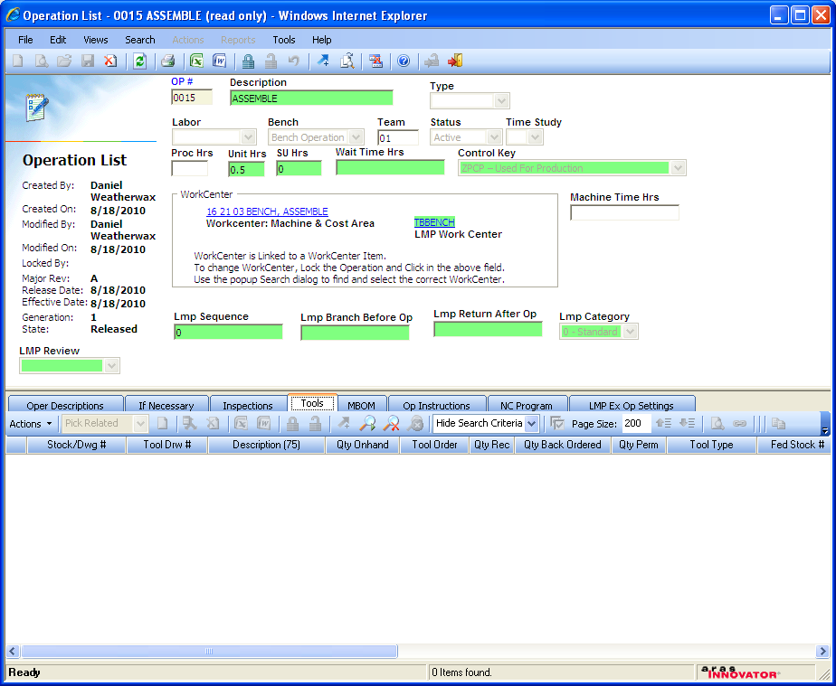
Manufacturing Operation Tools
Required Tooling, Gauges, Consumables
Quantity On Hand
Quantity Back Ordered

Slide 22
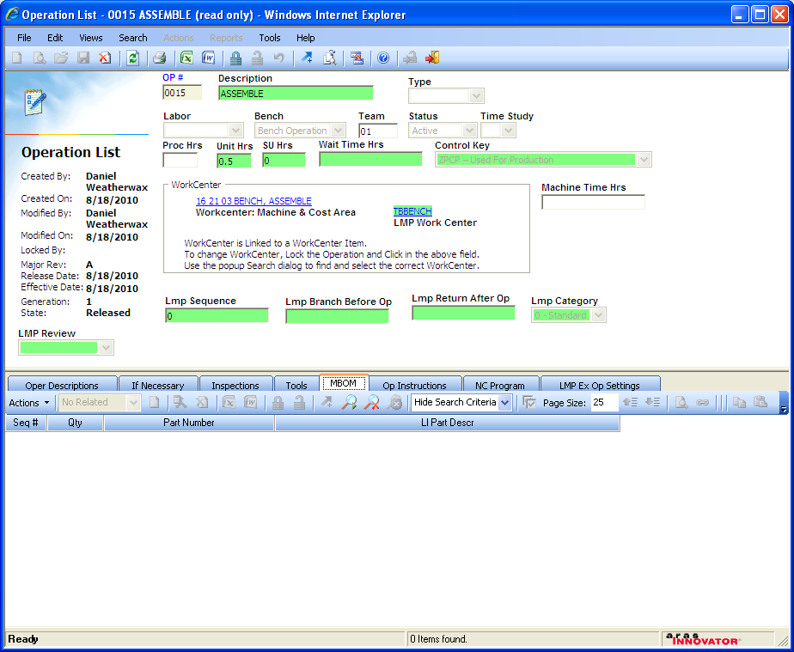
Manufacturing Operation MBOM Parts & Quantities
MBOM Part Quantities
MBOM Parts & Description
MBOM Assembly Sequence

Slide 23
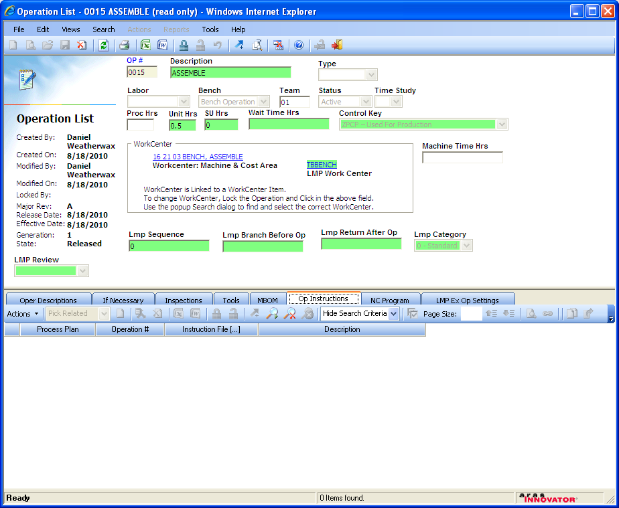
Manufacturing Operation Work Instructions
Operator Labor Instructions / Lean Six Sigma Method Sheets
Graphical Method Sheets & File Attachments

Slide 24
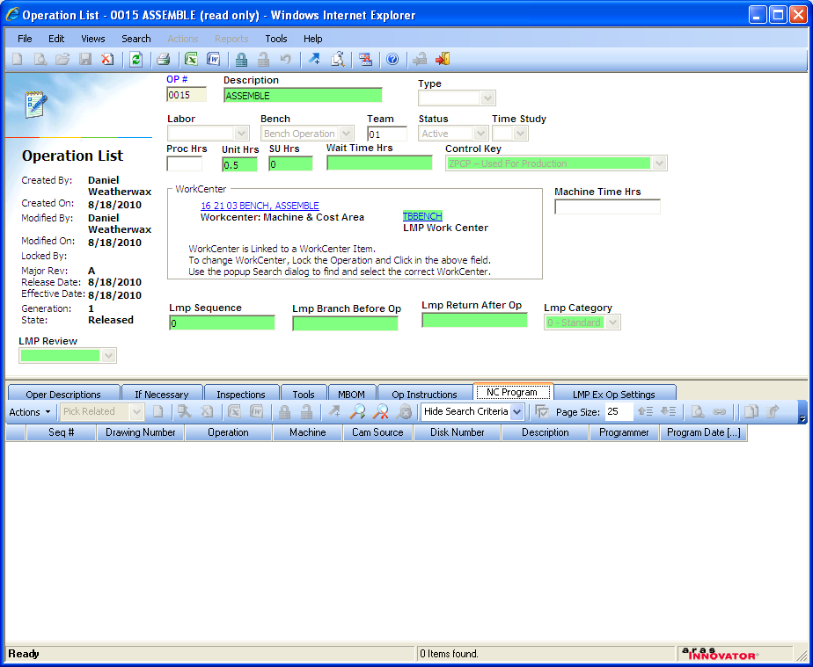
Manufacturing Operation NC Files
CAM program
CAM program release date
Part/Drawing
Machine

Slide 25
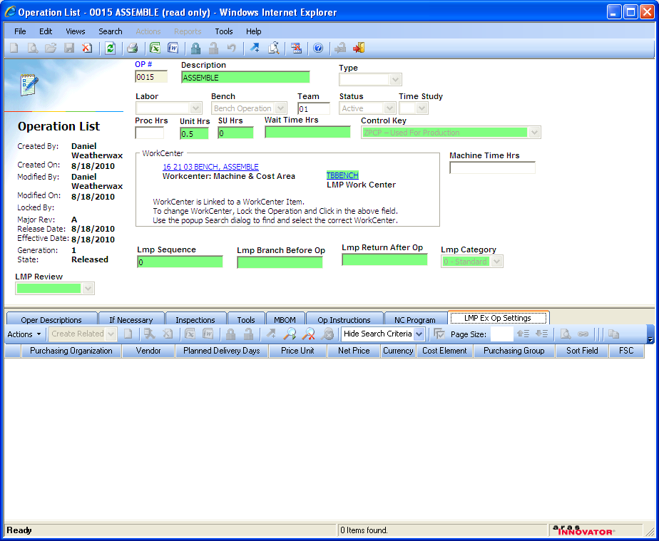
Manufacturing Operation ERP/MRP Information
Vendor
Delivery Days
Price
Purchasing Group
Currency

Slide 26
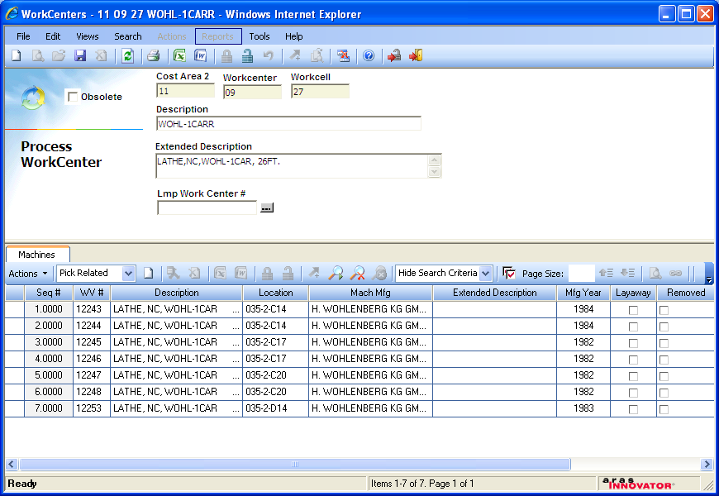
Process WorkCenter Machining Steps
Workcenter & Workcell
Machine
Machining Operations

Slide 27
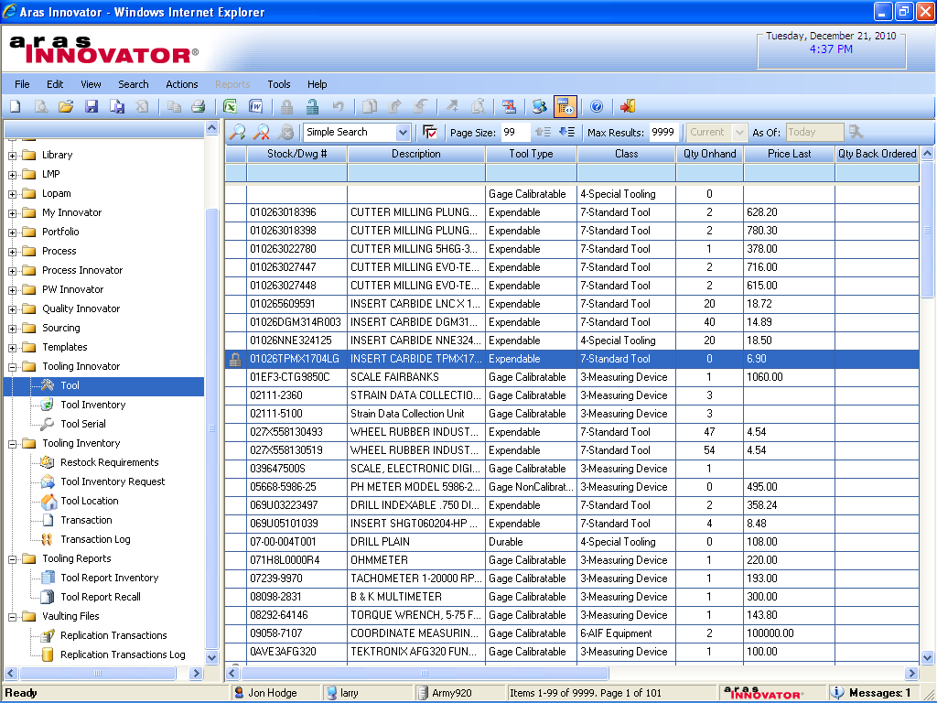
Tooling & Equipment Assets
Tooling Design Drawing DWG #
Asset Value
Asset Type
Asset Quantity

Slide 28
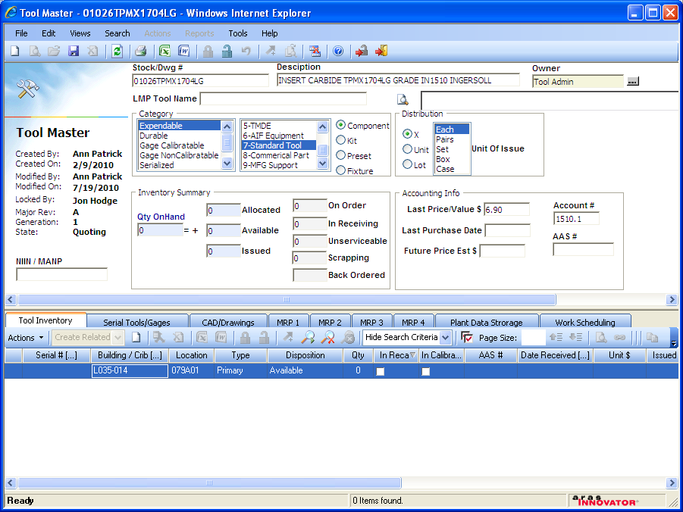
Tool Master & Tool Crib Check-in / Check-out
Asset Value
Asset Status
Asset Location
Maintenance & Calibration Status
Tool Inventory

Slide 29
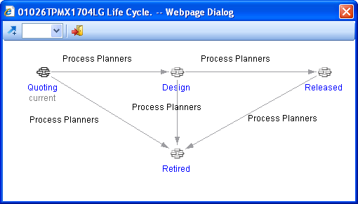
Tool Master Lifecycle

Slide 30
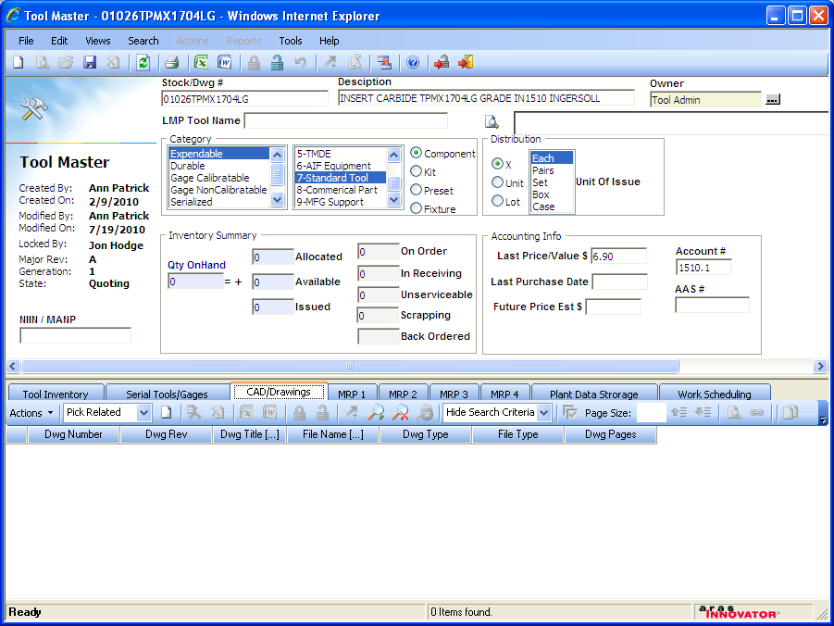
Tool Master CAD Drawings
Drawing DWG & Rev
Drawing File Attachment

Slide 31
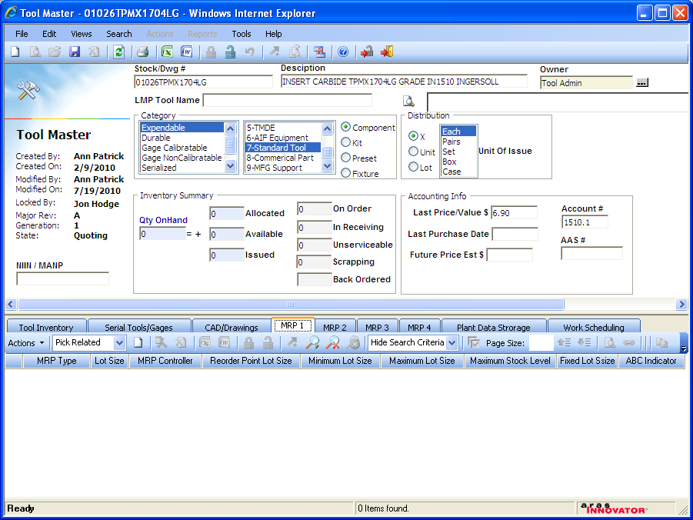
Tool Master ERP/MRP Information
SAP Integration
Max Stocking Level
Activity Based Costing
Lot Size
Reorder Point
Min / Max Lot Size

Slide 32
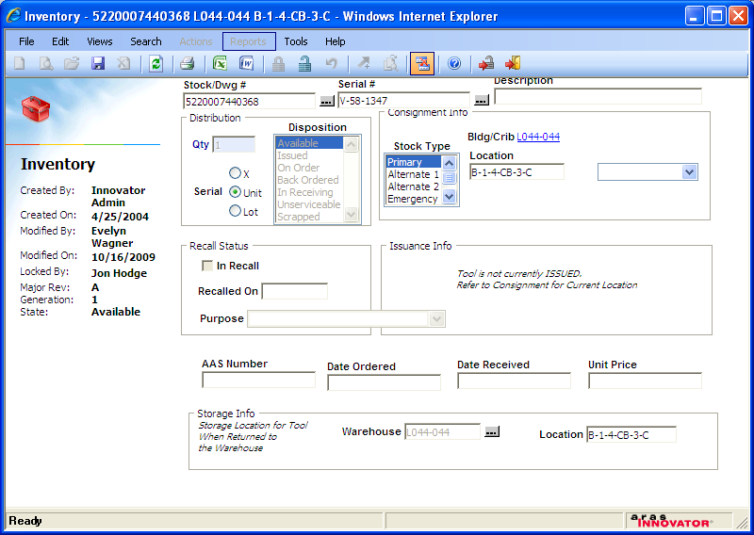
Tool Inventory
Tool Crib Location
Recall Information
Tool Inventory Status
Tool Inventory Location

Slide 33
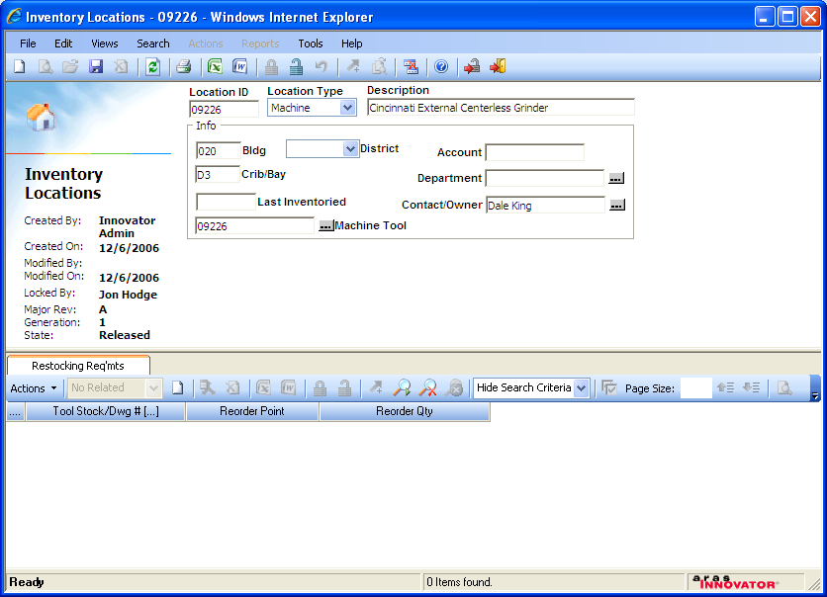
Tooling Crib Inventory Locations
Configurable Tool Inventory Locations
Tool DWG #
Reorder Point
Reorder Quantity

Slide 34
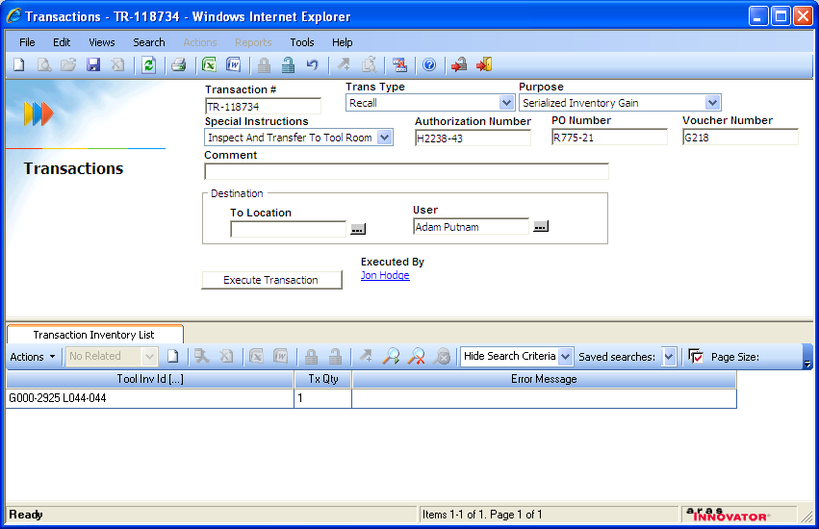
Tooling Crib Check-in / Check-out
PO Information
Tool Crib Check-in / Check-out

Slide 35
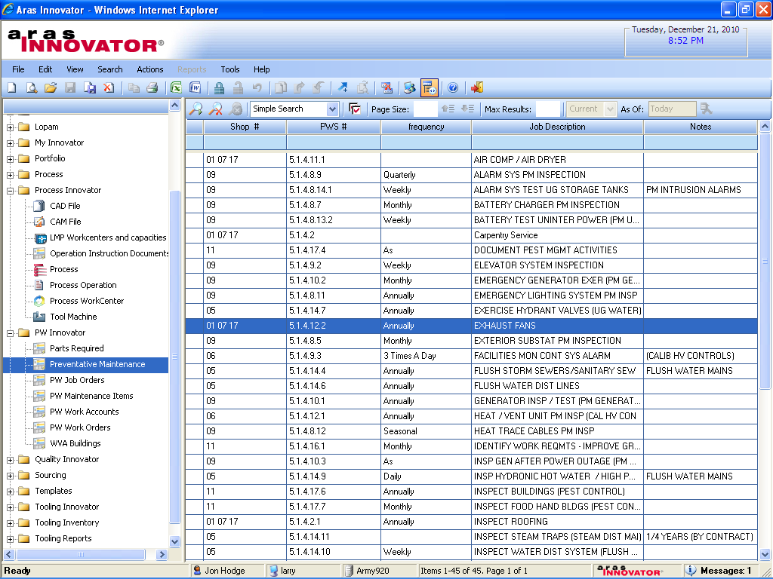
Preventive Maintenance Equipment & Tooling
PM Assets
PM Activities

Slide 36
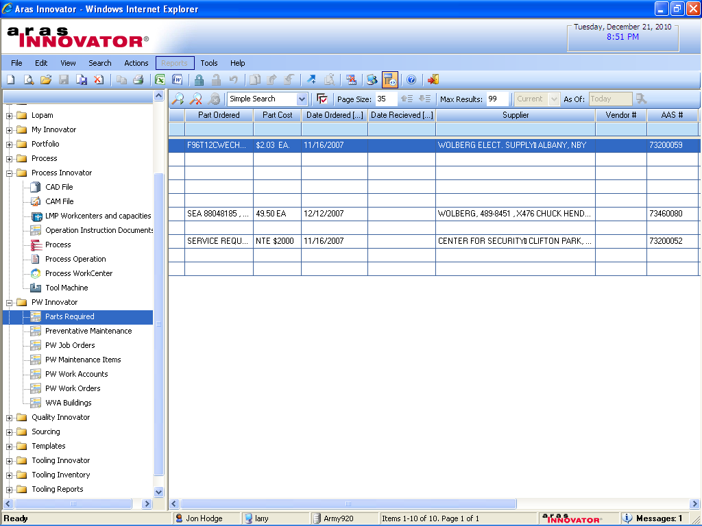
Preventive Maintenance Parts Required
PM Parts
PM Parts Order & Received Dates
PM Part Costs
PM Part Qualified Suppliers

Slide 37
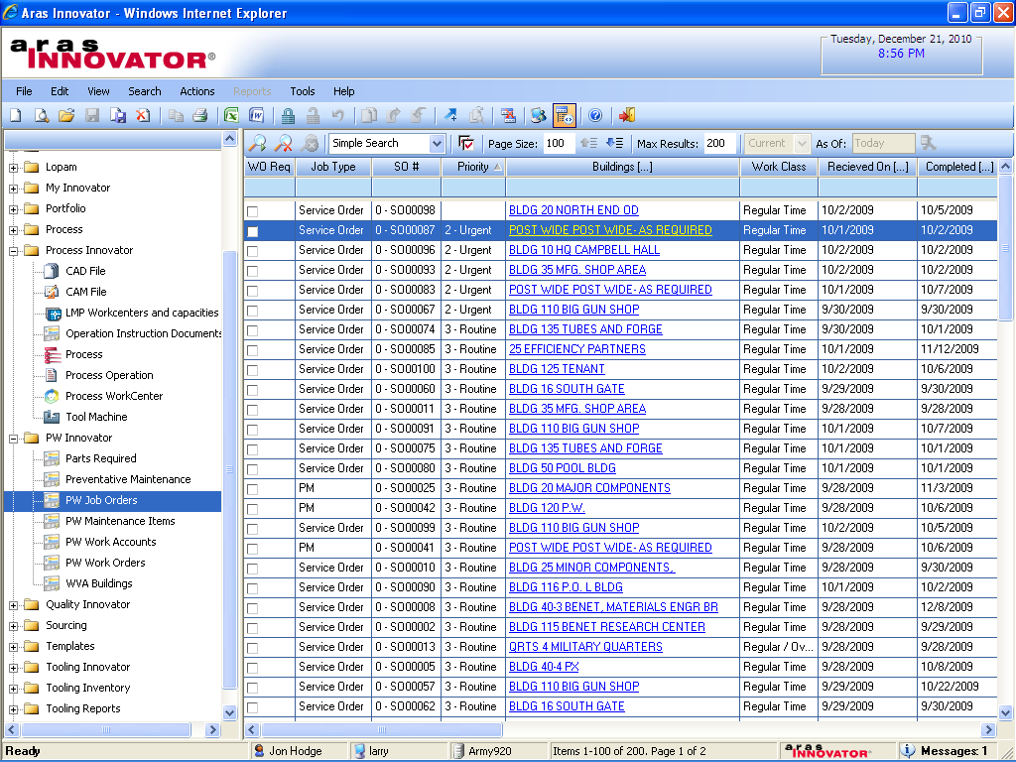
Preventive Maintenance Job Orders
PM Priority
PM Schedule

Slide 38
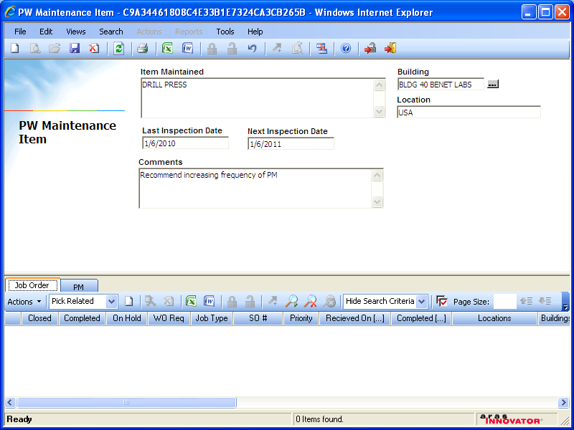
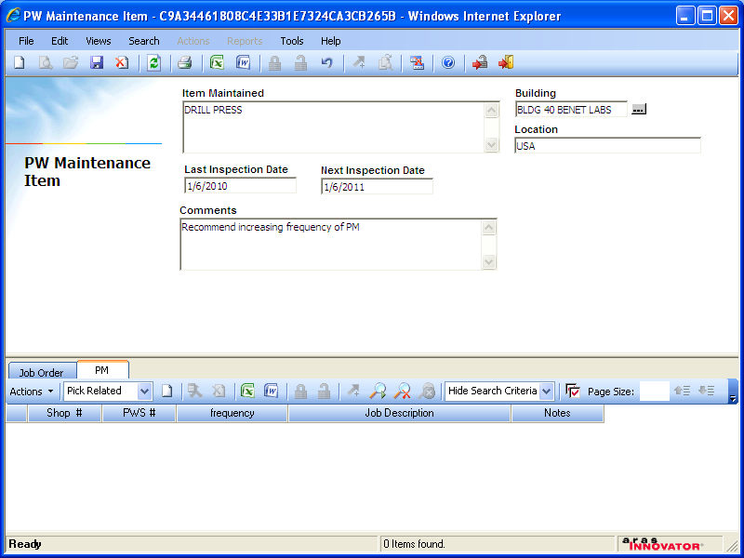
Preventive Maintenance Details
PM Schedule Last PM Date & Next PM Date
PM Status
PM Location & Work Details
PM Frequency

Slide 39
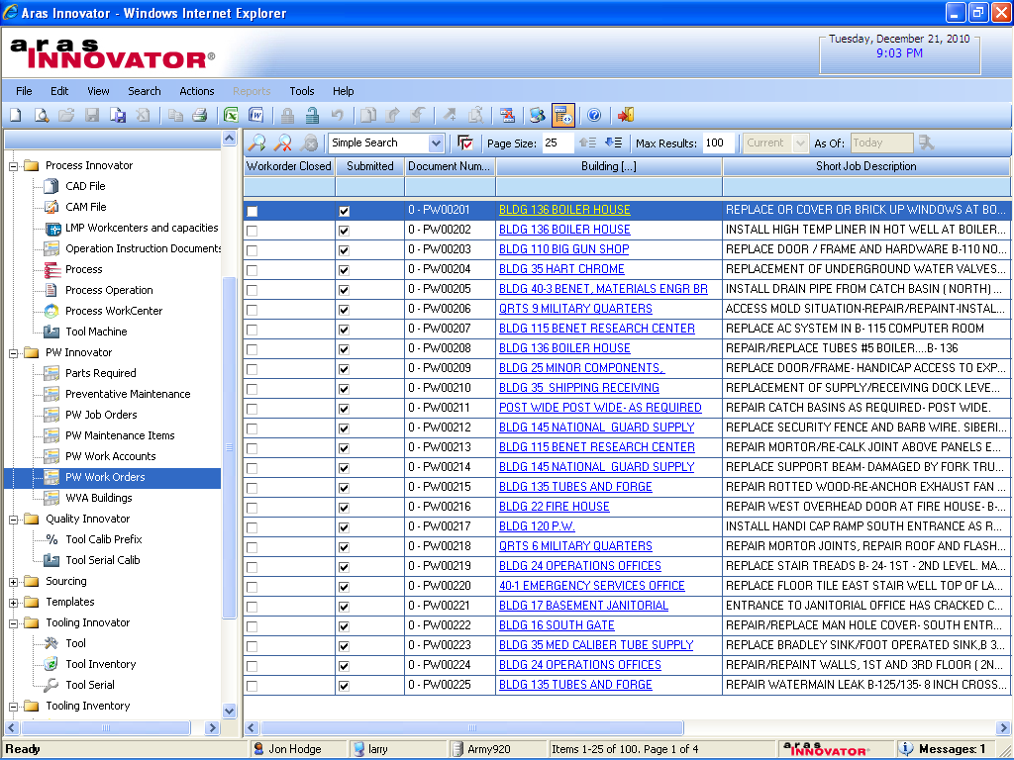
Preventive Maintenance Work Orders
PM Jobs & Details

Slide 40
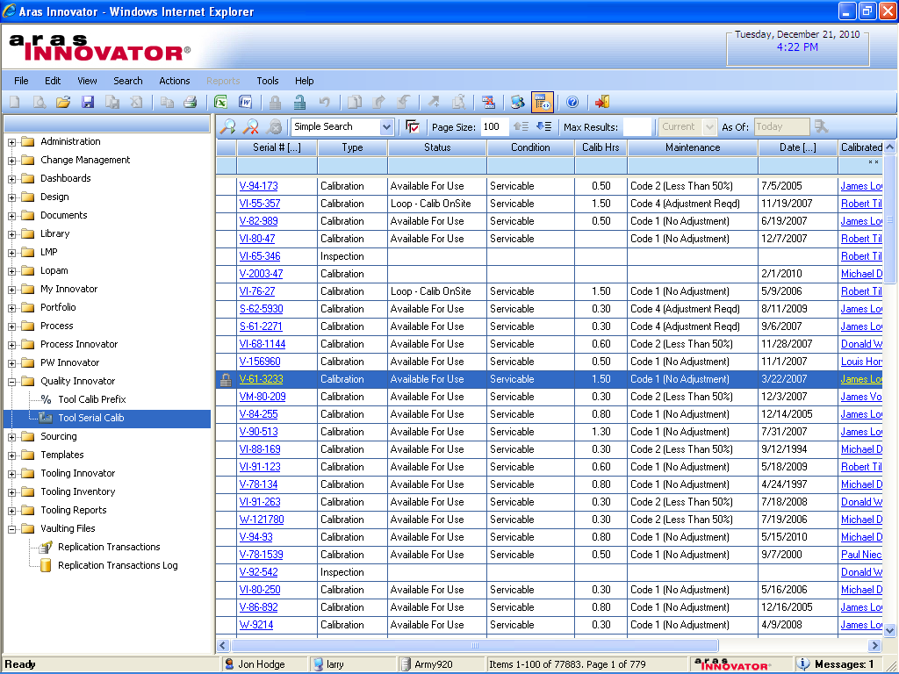
Serialized Gauge Calibration List
Serialized Asset Tracking
Maintenance Info
Status
Cal Date

Slide 41
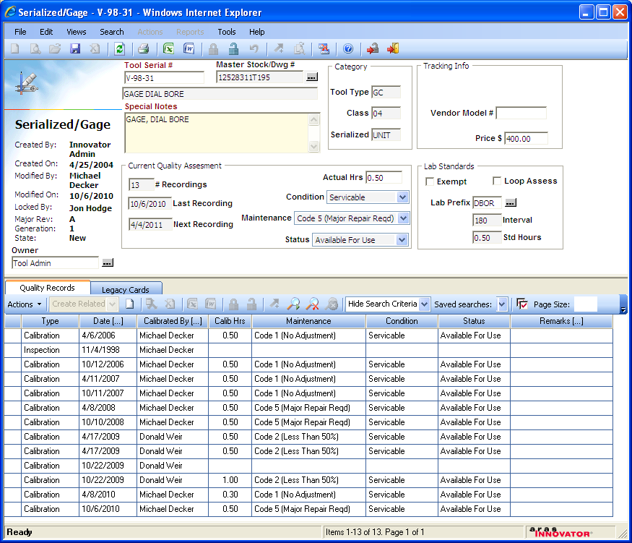
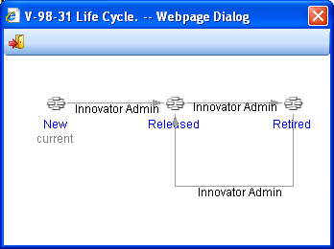
Serialized Gauge & Lifecycle with Calibration History
Master Design Drawing DWG
Asset Value
Serialized Asset Lifecycle
Calibration History

Slide 42
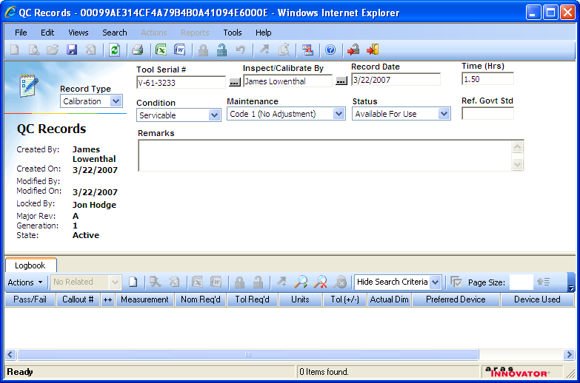
Serialized Gauge Calibration QC Logbook Record
Cal Time
Calibration Authority Standard
Logbook
Status
Actual Dimensions
Pass / Fail Record
Measurement Method
Tolerance

